Slide 1
Advanced C++ Internals: Chapter 12: C++ Template Functions
ZACOCPPINT

Slide 2
Learning Journey:
Introducing Template Functions
Template Function Visualization
Common uses
Sum operations on Our Classes
Operator Delegations
Postfix ++/--
Generic Sum Operators
Accessing Templated Operators
Template Function Instantiation
Lab #17
Template Functions from a coding perspective
Lab #18
Template Functions from a reverse engineering perspective
Summary
Appendices:
Useful links
Learning Outcomes:
Must be able to describe Template Functions
Should be able to identify Template Function implementation artifacts in memory
Could be able to manipulate Template Function implementation to alter code behaviour
Template Functions

Slide 3
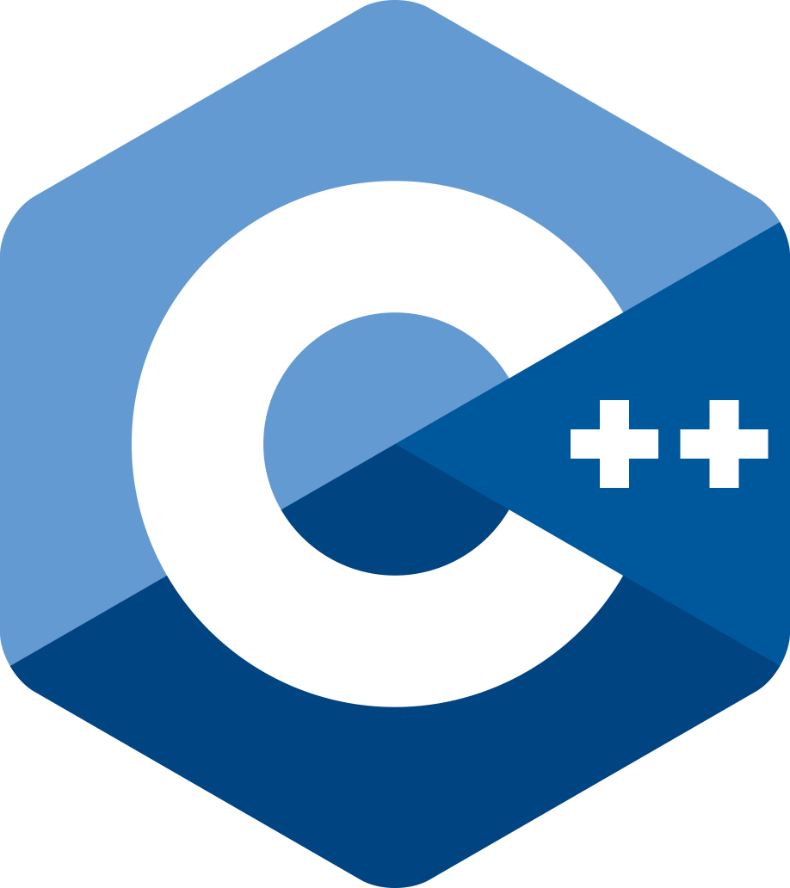
Q. What’s a Template Function?
A function defined with one or more template parameters.
This allows the function to work with different types without any need to explicitly specify those types.
Allows C++ programmer to write generic, reusable code.
Introducing
Template Functions
template <typename T>
void swapValues(T &a, T &b) {
T temp = a;
a = b;
b = temp;
}
Notes:
Templates have been available from the earliest design aspects of C++, but were only finalised and formalised with the ISO C++98 standard.
In this example, the templated function could be called using integers, floats etc.
“T” is simply the placeholder for a real type.
Each type becomes “T”, allowing the declaration of “T” type variables used in the swap mechanism (notice the references).
Template functions have been around for a while but have seen modifications in C++11 and C++20 to certain aspects.

Slide 4
template <typename T>
void swapValues(T &a, T &b) {
T temp = a;
a = b;
b = temp;
}
void swapValues(int &a, int &b) {
int temp = a;
a = b;
b = temp;
}
void swapValues(float &a, float &b) {
float temp = a;
a = b;
b = temp;
}
Template
Function Visualization
Notes:
The compiler will generate the specific version of the template function as each type is passed as its pair of arguments, i.e. int, float etc.

Slide 5
Common Uses
Template functions have several different uses:
Generic algorithms
Data Structures, e.g. Standard Template Library (STL)
Operator Overloading
Especially within classes to represent common arithmetic operations

Slide 6
class Hopper {
public:
// modifiers
int remove(int amount);
Hopper& operator-=(int amount) { remove(amount); return *this; };
Sum-operations on Our Classes
Drink DrinkMachine::make_drink(Recipe drinkRecipe) {
if (can_make_drink(drinkRecipe)) {
_coffeeHopper -= drinkRecipe.beans_g;
_waterHopper -= drinkRecipe.water_ml;
_milkHopper -= drinkRecipe.milk_ml;
return Drink{ (drinkRecipe.name + add_sugar()).c_str()
,drinkRecipe.water_ml + drinkRecipe.milk_ml };
}
else return Drink{};
}
Notes:
We can make deducting recipe-amounts from our hoppers easier by providing suitable the -= operator for the Hopper class.

Slide 7
Family | Provide | Derive
Boolean | ==, <=> | !=, <=, >=
Sum | +=, -=, Unary- | +, -, ++, -- (pre and post-fix)
Product | *=, invert | *, /, /=, %, %=
Bitwise | |=, &=, >>=, <<= | |, &, ^, >>, <<, ^=
Operator Delegation
Notes:
For each class of operator, we can derive some of them from a defined sub-set. This is called operator delegation.

Slide 8
Hopper& operator-(int amount) { auto result = *this; return result -= amount; };
Hopper& operator--() { return (*this) -= 1; }
const Hopper operator--(int) {const auto copy = *this; --(*this); return copy; }
Postfix ++/--
Delegate post-fix to pre-fix (semantic expectation)
Postfix returns const copy
Where would the second decrement go?
auto bug = waterHopper-- --;
Notes:
The post-fix increment & decrement operators take an un-named int argument. This is an ugly trick to signal to the compiler which operator to use. No argument is actually generated or used!
Const copy return values are not normally useful - its a copy, so why bother to make it constant; it offers no protection! Code-linters may scold you. However, in this case it provides an important protection against a bug.

Slide 9
namespace sum_Operators {
template<typename T>
T operator +(T lhs, const T& rhs) { return lhs += rhs; }
template<typename T>
T& operator ++(T& lhs) { return lhs += 1; }
template<typename T>
T operator ++(T& lhs, int) { const T copy{ lhs }; ++lhs; return copy; }
template<typename T, typename N>
T operator +(T lhs, N rhs) { return lhs += rhs; }
...
}
Generic Sum Operators
likewise for the - operators
Notes:
template<typename T>
"template" tells the compiler that the following definition is generic code that is to be expanded at the point where it is called by the client.
<typename T> tells the compiler that the identifier T is a place-holder for a type-name.
You may see <class C> in older code. The meaning is the same.
T is just a place-holder-name. You can use any descriptive name you wish.
The list inside the < > are called the template parameters. They are usually typename's but do not have to be. They can also be values of specified types, such as int or Widget or auto. Value template arguments must be compile-time constants

Slide 10
namespace hopper {
using namespace sum_Operators;
class Hopper {
public:
Accessing Templated Operators
{ using namespace hopper;
auto waterHopper = Hopper{ "Water", 100 };
waterHopper.refill(waterHopper.capacity());
cout << "waterHopper Post--:" << int(waterHopper--)
<< " Pre--: " << int(--waterHopper) << endl;
}
{ auto drink = Drink(100);
using namespace sum_Operators;
cout << "drink Post--:" << drink--.amount_left()
<< " Pre--: " << (--drink).amount_left() << endl;
auto combineDrinks = drink + Drink(50);
auto topUp = combineDrinks + 25;
}
Notes:
If a class needs to make use of templated helper functions, such as these templated sum operators, it is best to place the class definition in its own separate namespace. That namespace can then bring in the specific functions required with using directives.

Slide 11
Templated functions and classes are only instantiated when called by client code.
Must be defined in header file to be accessible to client.
Templated class member functions - only those called are instantiated.
Template Function Instantiation
Notes:
Template overloading and template specialisation are beyond the scope of this course.

Slide 12
C++ Internals Lab #17
Template Functions (coding perspective)
Notes:
This lab focuses on using Template Functions from a coding perspective

Slide 13
C++ Internals Lab #18
Template Functions (reverse engineering perspective)
Notes:
This lab focuses on Template Functions – from a reverse engineering perspective

Slide 14
Template Functions are defined with one or more template parameters
Allows programmer to write generic, reusable code
Function works with different types, identified through their call mechanism
Common uses include:
Generic algorithms
Data Structures
Operator Overloading
Operator delegation allows compiler to derive some of the operators from a programmer defined sub-set.
Templated helper functions are frequently used to provide generic functionality that can be applied to assorted data types.
e.g. sum, increment, decrement, min, max etc.
Summary

Slide 15
Any questions?

Slide 16
Appendices
Notes:
Some additional information you may find useful…

Slide 17
Websites and online resources
GCC, the GNU Compiler Collection (no date) GCC, the GNU Compiler Collection - GNU Project. Available at: https://gcc.gnu.org/ (Accessed: 16 November 2023).
Clang 18.0.0git documentation (no date) Clang Compiler User’s Manual - Clang 18.0.0git documentation. Available at: https://clang.llvm.org/docs/UsersManual.html (Accessed: 18 December 2023).
C++ Standard Library (no date) cppreference.com. Available at: https://en.cppreference.com/w/cpp/standard_library (Accessed: 16 November 2023).
JTC1/SC22/WG21 - The C++ Standards Committee - ISOCPP (no date) . Available at: https://www.open-std.org/jtc1/sc22/wg21/ (Accessed: 16 November 2023).
Useful resources

Slide 18
Review of Chapter’s Learning Outcomes

Slide 19
Learning Outcomes:
By the completion of this chapter, you…
Must be able to describe Template Functions
Should be able to identify Template Function implementation artifacts in memory
Could be able to manipulate Template Function implementation to alter code behaviour
Please review these learning outcomes at chapter's end.
Learning Outcomes

